Slide 1

Disney Hot Star – Data Analysis
Ramya Raghavan
MB28
Capstone Project III

Slide 2
Disney & Hot Star Introduction
Disney+ Hotstar is a leading streaming platform in India, created through Disney's acquisition of Star India and its rebranding of Hotstar. As a key player in the Indian digital entertainment market, Disney+ Hotstar offers a diverse mix of content, including movies, TV shows, and live sports, catering to a broad audience with its freemium and subscription models.
Business Highlights:
Market Position:
Disney+ Hotstar dominates the Indian streaming landscape, driven by exclusive rights to major sports events like the IPL and a rich library of regional and international content.
Revenue Streams:
The platform operates on a freemium model with ad-supported free content and a premium subscription tier offering ad-free experiences. Advertising revenue, particularly from sports content, is a significant driver of income.
Strategic Importance:
Integrating Disney’s extensive content portfolio with Hotstar's strong local market presence, Disney+ Hotstar is well-positioned to capture a substantial share of the growing digital entertainment market in India and beyond.
Future Outlook:
Disney+ Hotstar’s continued focus on exclusive content and regional programming will be crucial in maintaining its competitive edge and expanding its user base in a rapidly evolving market.

Slide 3
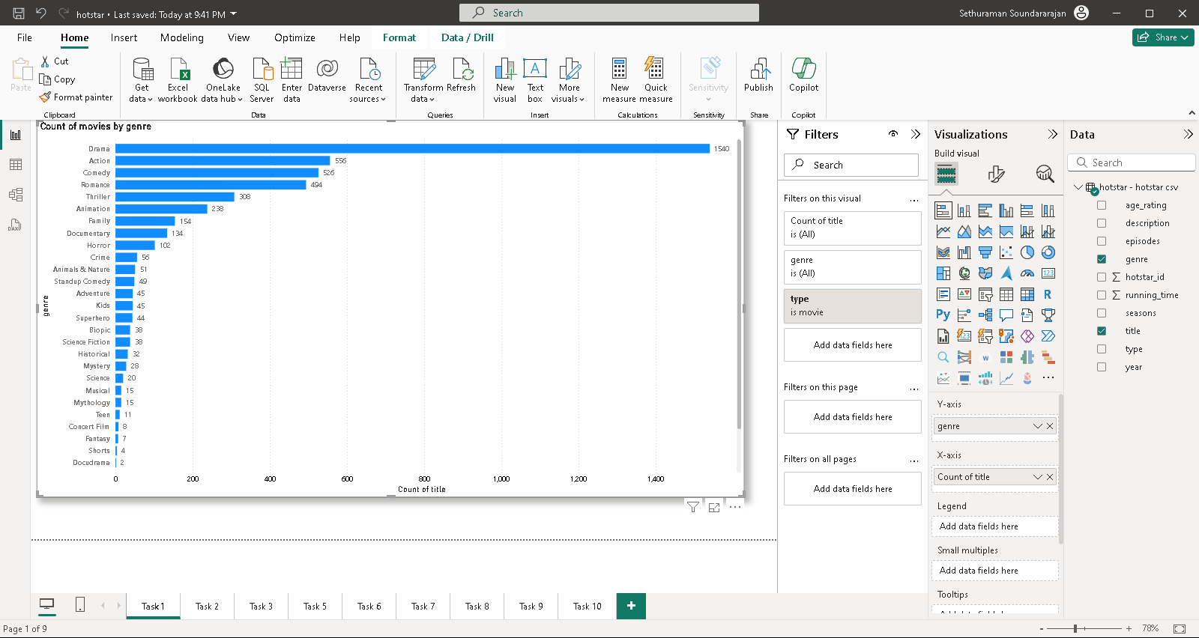
Task 1 : Distribution of Movies by Genre
Genre | Count of title
Drama | 1540
Action | 556
Comedy | 526
Romance | 494
Thriller | 308
Animation | 238
Family | 154
Documentary | 134
Horror | 102
Crime | 56
A bar chart is created to show the count of movies for each genre. Since there are two categories of show type is telecasted , the filter movie is used and the data are extracted in a table and displayed.

Slide 4
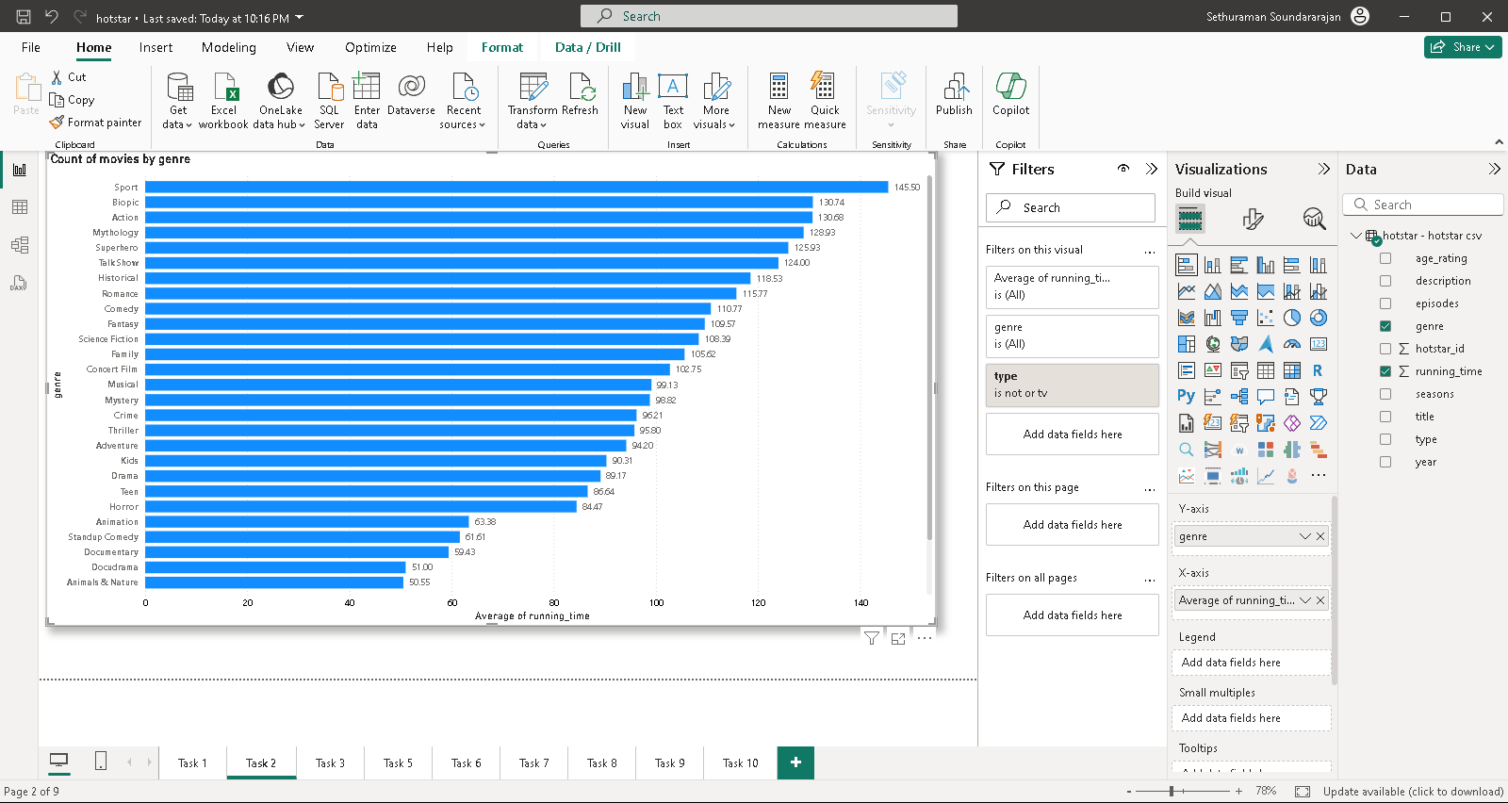
Task 2 : Average Running Time by Genre
Genre | Average of running_time
Sport | 145.5
Biopic | 130.74
Action | 130.68
Mythology | 128.93
Superhero | 125.93
Talk Show | 124
Historical | 118.53
Romance | 115.77
Comedy | 110.77
Fantasy | 109.57
A bar chart is created to show the average running time for each genre. Since there are two categories of show type is telecasted , the filter movie is used and the data are extracted in a table and displayed.

Slide 5
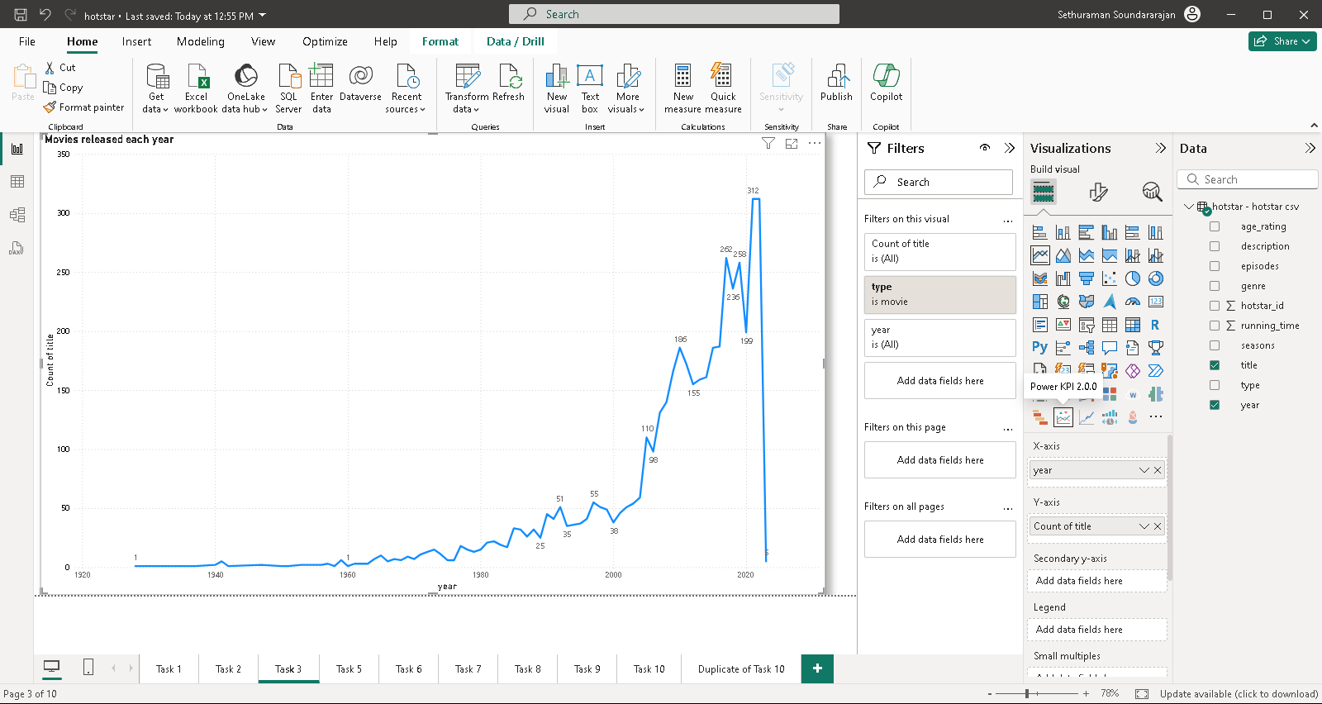
Task 3 : Movies released each year
Count of Movies | Year
312 | 2021
312 | 2022
262 | 2017
258 | 2019
236 | 2018
199 | 2020
187 | 2016
186 | 2010
186 | 2015
172 | 2011
A line chart is created to show Movies that released each year. Since there are two categories of show type is telecasted , the filter movie is used and the data are extracted in a table and sorted in descending order and displayed.

Slide 6
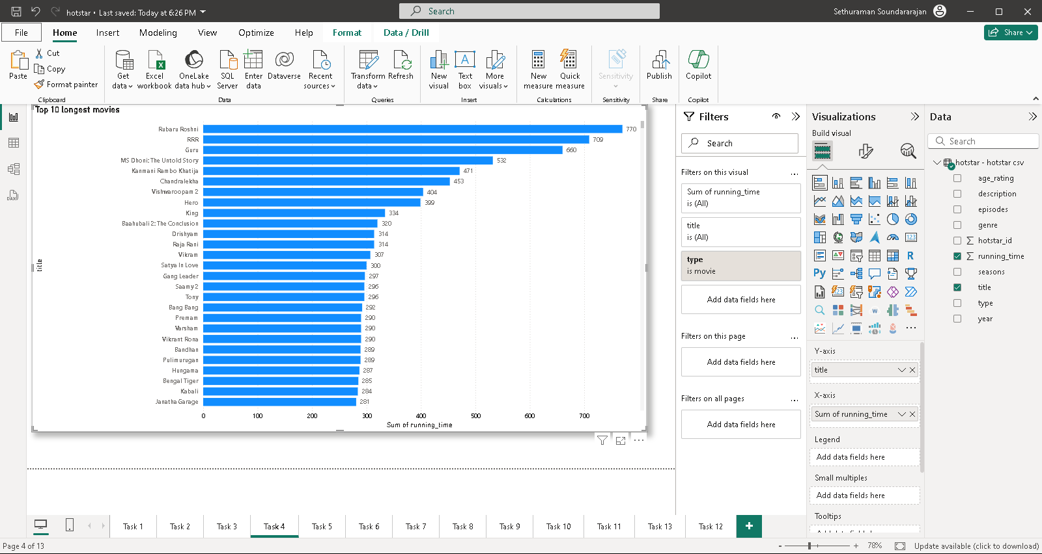
Task 4 : Top 10 longest movies
Title | Running time
Rubaru Roshni | 770
RRR | 709
Guru | 660
MS Dhoni: The Untold Story | 532
Kanmani Rambo Khatija | 471
Chandralekha | 453
Vishwaroopam 2 | 404
Hero | 399
King | 334
Baahubali 2: The Conclusion | 320
A line chart is created to show top 10 longest movies. Since there are two categories of show type is telecasted , the filter movie is used and the data are extracted in a table and sorted in descending order and displayed.

Slide 7
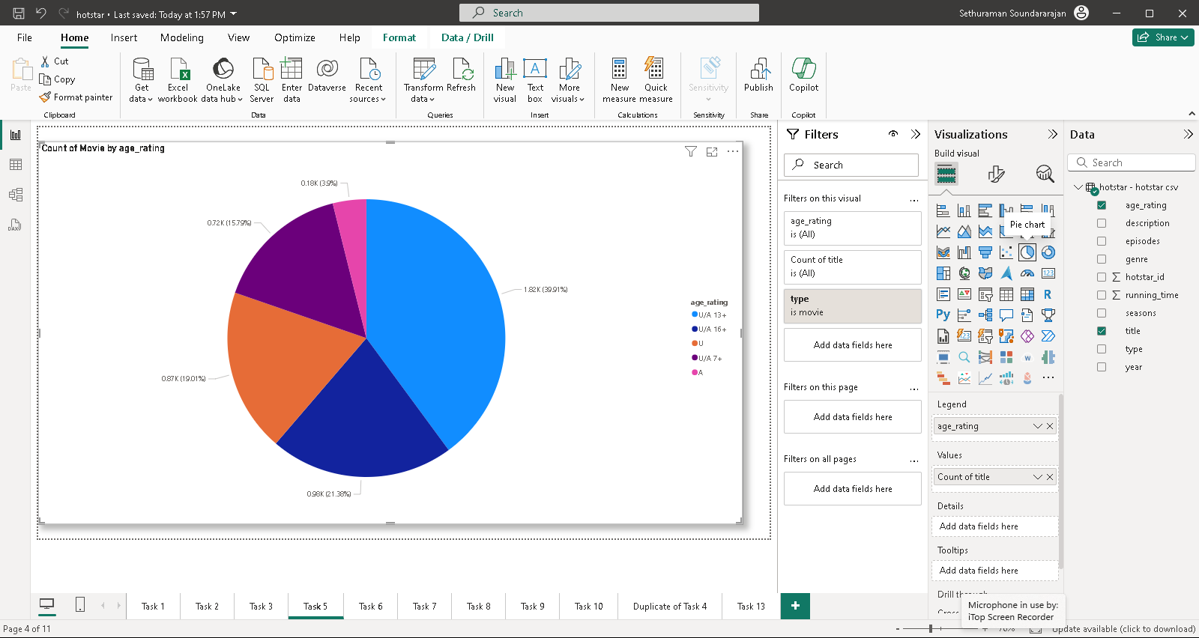
Task 5 : Movies by Age Rating
Count of Movies | Age_rating
1820 | U/A 13+
967 | U/A 16+
866 | U
720 | U/A 7+
177 | A
A pie chart is created to show Movies by age rating. Since there are two categories of show type is telecasted , the filter movie is used and the data are extracted in a table and sorted in descending order and displayed.

Slide 8
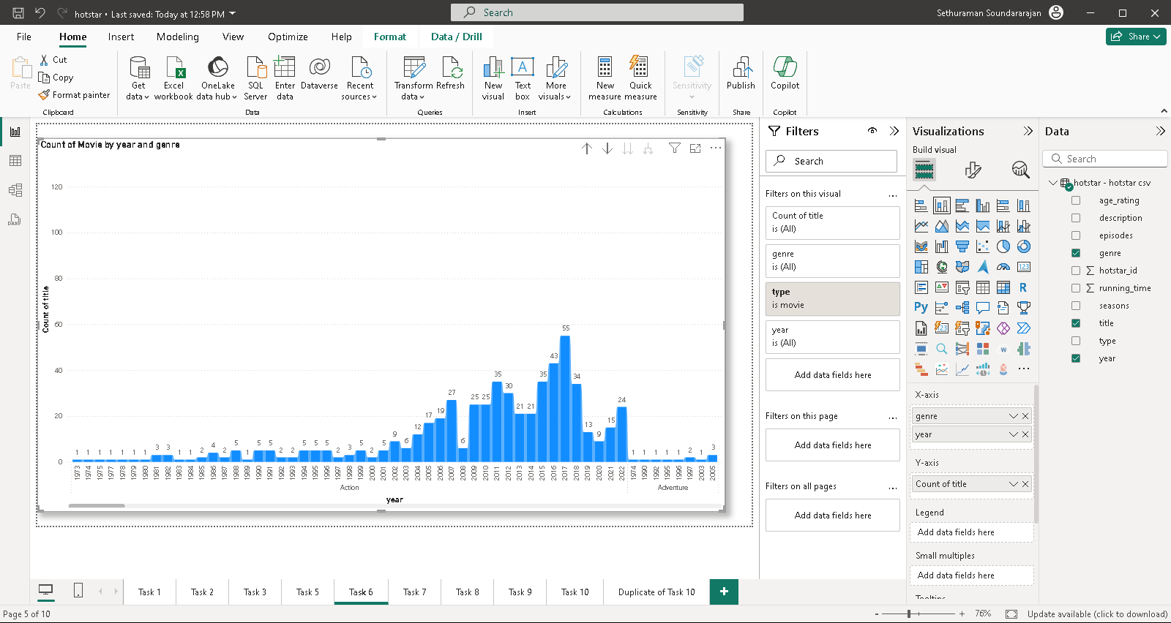
Task 6 : Movies by year and genre
Genre | Count of Movie | Year
Drama | 127 | 2022
Drama | 126 | 2021
Drama | 93 | 2019
Drama | 91 | 2020
Drama | 69 | 2008
Drama | 69 | 2018
Drama | 62 | 2017
Drama | 59 | 2009
Drama | 59 | 2010
Action | 52 | 2017
A stacked column chart is created to show movies by year and genre. Since there are two categories of show type is telecasted , the filter movie is used and the data are extracted in a table and sorted in descending order and displayed.

Slide 9
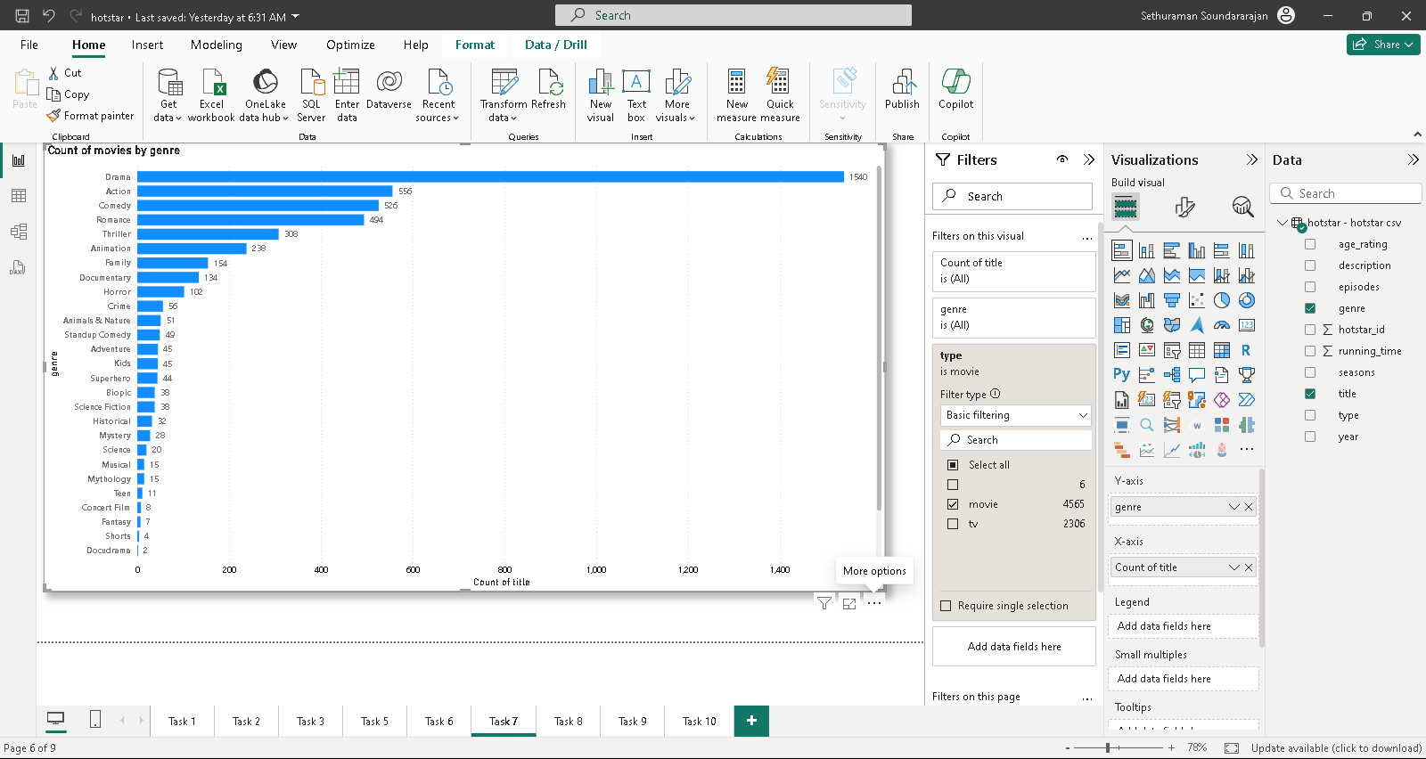
Task 7 : Common movie type by year
Genre | Count of Movie | Year
Drama | 127 | 2022
Drama | 126 | 2021
Drama | 93 | 2019
Drama | 91 | 2020
Drama | 69 | 2008
Drama | 69 | 2018
Drama | 62 | 2017
Drama | 59 | 2009
Drama | 59 | 2010
Action | 52 | 2017
A stacked column chart is created to show Movies by genre. Since there are two categories of show type is telecasted , the filter movie is used and the data are extracted in a table and sorted in descending order and displayed.

Slide 10
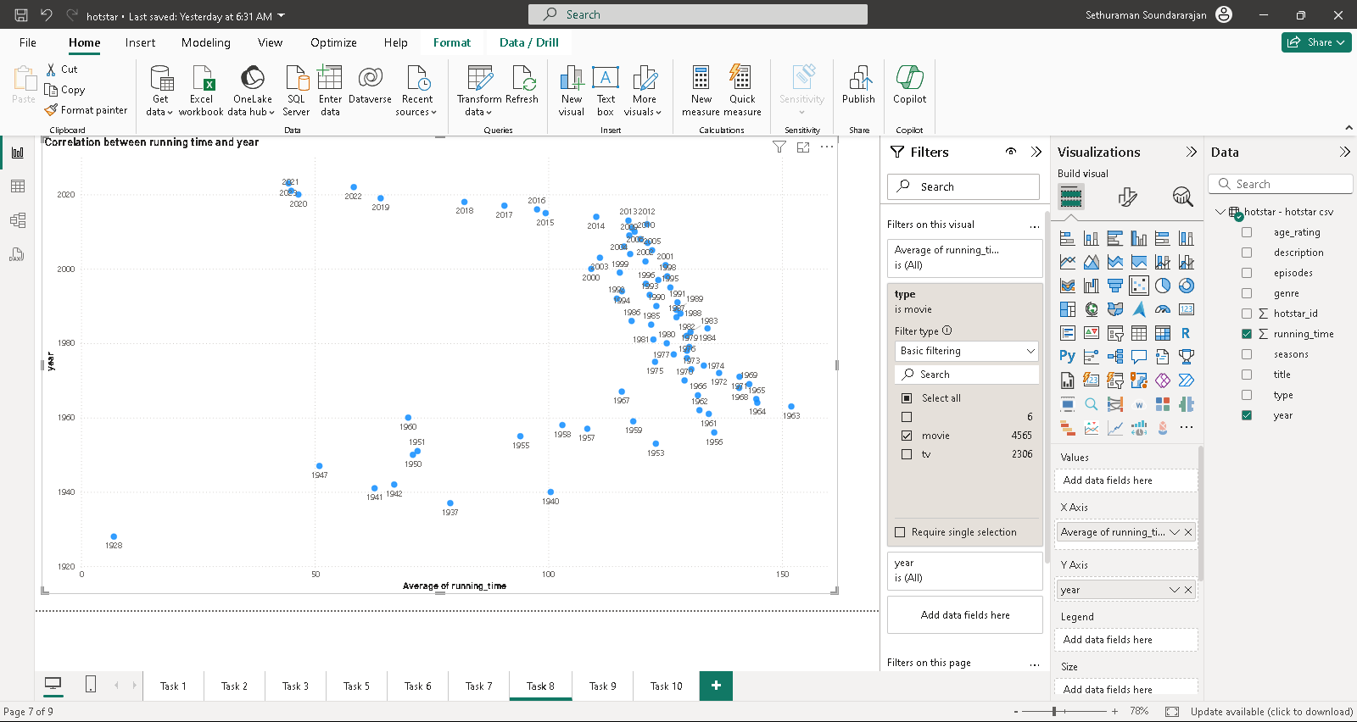
Task 8 : Correlation Between Running Time and Year
Running_time | Year
152 | 1963
144.71 | 1964
144.5 | 1965
143 | 1969
140.91 | 1971
140.83 | 1968
136.54 | 1972
135.5 | 1956
134.33 | 1961
134.06 | 1984
A scatter plot is created to show the correlation between running time and year. Since there are two categories of show type is telecasted , the filter movie is used and the data are extracted in a table and sorted in descending order and displayed.

Slide 11
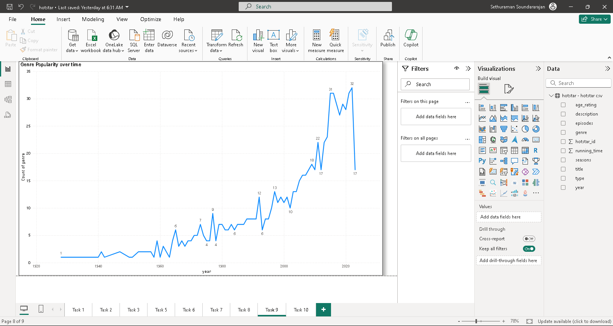
Task 9 : Genre Popularity Over Time
Count of genre | Year
32 | 2022
31 | 2015
31 | 2016
31 | 2021
29 | 2017
29 | 2019
28 | 2020
27 | 2018
23 | 2014
22 | 2011
A Line chart is created to show the genre popularity over the time. The data are extracted in a table and sorted in descending order and displayed.

Slide 12
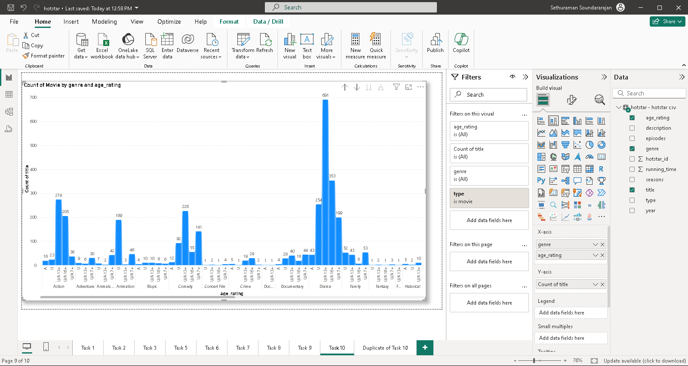
Task 10 : Movies by Genre and Age Rating
Genre | Count of movies | Age rating
Drama | 691 | U/A 13+
Drama | 352 | U/A 16+
Action | 272 | U/A 13+
Drama | 254 | U
Romance | 250 | U/A 13+
Comedy | 226 | U/A 13+
Action | 200 | U/A 16+
Drama | 198 | U/A 7+
Animation | 188 | U
Comedy | 141 | U/A 7+
A stacked column chart created to show the movies by genre and Age Rating. Since there are two categories of show type is telecasted , the filter movie is used and the data are extracted in a table and sorted in descending order and displayed.

Slide 13
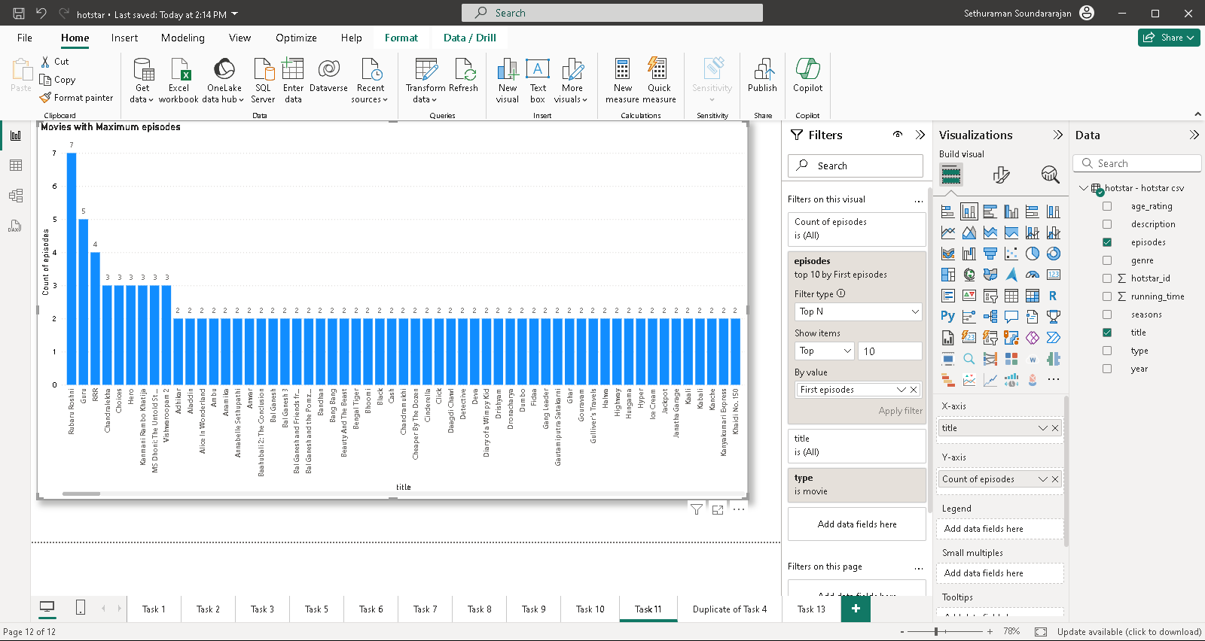
Task 11 : Movies with Maximum episodes
Title | Count of episodes
Rubaru Roshni | 7
Guru | 5
RRR | 4
Chandralekha | 3
Choices | 3
Hero | 3
Kanmani Rambo Khatija | 3
MS Dhoni: The Untold Story | 3
Vishwaroopam 2 | 3
Adhikar | 2
Aladdin | 2
A stacked column chart created to show the movies with maximum episodes. Since there are two categories of show type is telecasted , the filter movie is used and the data are extracted in a table and sorted in descending order and displayed.

Slide 14
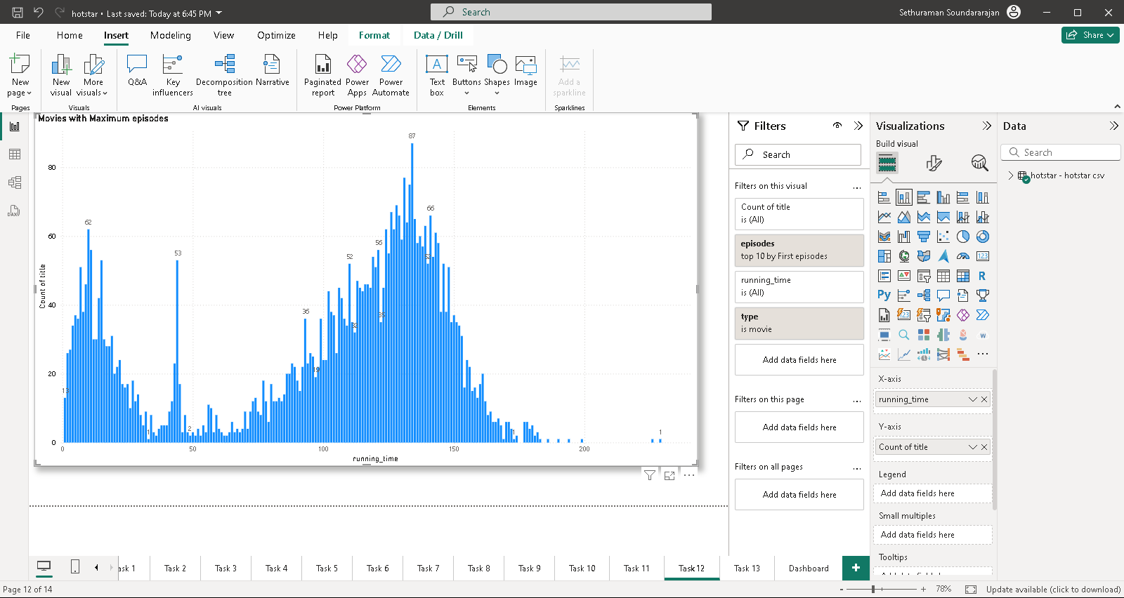
Task 12 : Distribution of Running Time
Running Time | Count of movies
134 | 87
131 | 77
133 | 75
128 | 69
126 | 67
141 | 66
129 | 66
135 | 65
132 | 64
139 | 63
A stacked column chart created to show distribution of running time. Since there are two categories of show type is telecasted , the filter movie is used and the data are extracted in a table and sorted in descending order and displayed.

Slide 15
Task 12 : Distribution of Running Time
Running Time | Count of movies
134 | 87
131 | 77
133 | 75
128 | 69
126 | 67
141 | 66
129 | 66
135 | 65
132 | 64
139 | 63
A stacked column chart created to show distribution of running time. Since there are two categories of show type is telecasted , the filter movie is used and the data are extracted in a table and sorted in descending order and displayed.

Slide 16
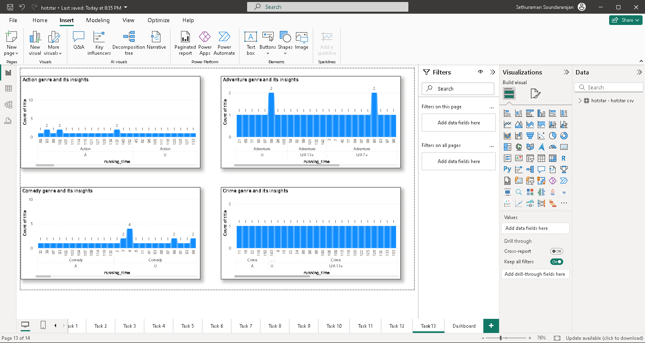
Task 13 : Analysis of Specific Genre
Age Rating | Count of movies | Running time | Genre
U/A 13+ | 1 | 190 | Action
U/A 16+ | 1 | 182 | Action
U/A 16+ | 2 | 178 | Action
U/A 13+ | 1 | 177 | Action
U/A 16+ | 3 | 177 | Action
U/A 13+ | 2 | 172 | Action
U/A 13+ | 2 | 171 | Action
U/A 16+ | 1 | 171 | Action
U/A 13+ | 1 | 170 | Action
U/A 13+ | 2 | 168 | Action
Age Rating | Count of movies | Running time | Genre
U/A 7+ | 1 | 149 | Adventure
U/A 13+ | 1 | 142 | Adventure
U/A 7+ | 1 | 140 | Adventure
U/A 13+ | 1 | 132 | Adventure
U/A 7+ | 1 | 130 | Adventure
U/A 7+ | 1 | 126 | Adventure
U/A 7+ | 2 | 119 | Adventure
U/A 7+ | 1 | 118 | Adventure
U/A 7+ | 2 | 112 | Adventure
U/A 7+ | 1 | 109 | Adventure
Age Rating | Count of Movies | Running time | Genre
U/A 13+ | 1 | 180 | Comedy
U/A 13+ | 1 | 179 | Comedy
U/A 13+ | 1 | 170 | Comedy
U | 1 | 165 | Comedy
U | 1 | 162 | Comedy
U/A 7+ | 2 | 162 | Comedy
U/A 7+ | 1 | 161 | Comedy
U | 1 | 160 | Comedy
U/A 13+ | 4 | 160 | Comedy
U/A 7+ | 1 | 158 | Comedy
Age Rating | Count of movies | Running time | Genre
U/A 7+ | 1 | 156 | Crime
U/A 13+ | 1 | 153 | Crime
U/A 16+ | 1 | 151 | Crime
A | 1 | 150 | Crime
U/A 16+ | 1 | 145 | Crime
U | 1 | 143 | Crime
U/A 16+ | 1 | 143 | Crime
U/A 16+ | 1 | 138 | Crime
U/A 16+ | 1 | 136 | Crime
U/A 16+ | 1 | 135 | Crime
Multiple stacked column chart are created to show the analysis of specific genre , the genre considered are Action, Adventure , Comedy and Crime. Since there are two categories of show type is telecasted , the filter movie is used and the data are extracted in a table and sorted in descending order and displayed.

Slide 17
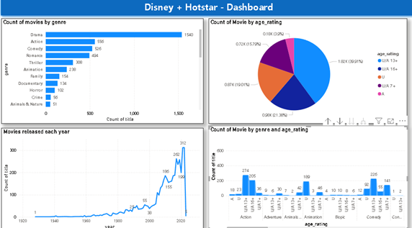
Disney + Hotstar Dashboard

Slide 18

Highlights and Summary
The dominant genre in the market is Drama, indicating strong audience engagement in this category. Sports films lead in average running time, suggesting a potential opportunity for longer-format storytelling in this genre.
The years 2021 and 2022 experienced the highest volume of movie releases, with 312 films each year. This trend highlights a potential saturation point in the market, warranting an analysis of consumer preferences and competitive positioning.
The film Rubaru Roshini holds the record for the longest runtime, followed by RRR. This data could inform production strategies, particularly in terms of pacing and audience retention for future projects.
The predominant age rating is U/A 13+, suggesting that content targeting younger audiences is prevalent. This could influence marketing strategies and content development to align with the interests and sensitivities of this demographic.

Slide 19
Business Recommendations
Focus on Drama Productions: Given that Drama is the top genre, invest in developing high-quality scripts and talent in this category. Consider partnerships with well-regarded directors and writers to enhance credibility and audience appeal.
Leverage Sports Genre Potential: With sports films having the longest average running time, explore the possibility of creating extended formats such as mini-series or documentaries that delve deeper into sports stories, which could attract both enthusiasts and casual viewers.
Market Analysis for Peak Release Years: Since 2021 and 2022 saw the highest number of releases, conduct a competitive analysis to understand consumer trends and preferences during these years. This can inform timing and marketing strategies for future releases to avoid saturation and optimize viewer engagement.
Utilize Lengthy Formats: Given the success of longer films like Rubaru Roshini and RRR, consider developing more ambitious projects that explore complex narratives. Evaluate audience feedback on pacing and engagement to refine this approach.
Target U/A 13+ Demographic: Since the most common age rating is U/A 13+, tailor marketing efforts to appeal to younger audiences and their parents. Create content that resonates with this demographic, incorporating themes and characters that reflect their experiences and values.
Data-Driven Marketing Strategies: Use audience analytics to refine marketing campaigns. Segment audiences based on their viewing habits and preferences to create targeted promotions that highlight films within the Drama and sports genres.
Diversify Content Offerings: Explore genres adjacent to Drama and sports that may attract the same audience, such as biopics or family-oriented films. This diversification can mitigate risks associated with genre-specific fluctuations in viewer interest.
Feedback Loop Implementation: Establish a robust mechanism for gathering audience feedback post-release. This will provide insights into viewer preferences and help refine future content strategies.
By implementing these recommendations, the business can enhance its market position, better meet audience demands, and optimize production and marketing efforts for greater success.

Slide 20
Thank You

